Slide 1
🎓 BLOCKCHAIN TECHNOLOGY PROJECT
Blockchain Certificate
Verification System
Combating Credential Fraud with Decentralized Trust & Smart Contracts
Ahmed Khoudja Fella • Tachche Aya
Implemented on Remix IDE • Solidity • Ethereum Testnet • 2025
⛓ Solidity
🔷 Ethereum
💻 Remix IDE
🔐 Smart Contracts

Slide 2
📖 Introduction — What is Blockchain?
Blockchain is a distributed system used to store data securely without a central authority.
🔗
🔐
👁️
Decentralized
Secure
Transparent
No single authority controls the network. Data is distributed across thousands of nodes worldwide — no single point of failure.
Each block is cryptographically linked to the previous one using SHA-256 hashing, making tampering mathematically impossible.
All transactions are publicly visible on the chain. Anyone can verify the data at any time — trust through transparency.
💡 Why Blockchain matters today: Credential fraud costs institutions billions. Blockchain provides mathematical proof — not just human trust.

Slide 3
❗ Problem Statement — The Credential Fraud Crisis
$1B+
85%
3–6 wks
70%
Annual global losses
from credential fraud
Employers who caught
lies on résumés
Average time to verify
a paper certificate
Fake diplomas that pass
manual inspection
❌ Fake Certificates — Fraudulent diplomas are indistinguishable from genuine ones without proper verification.
🔍 Difficult Verification — Employers must contact institutions directly, a slow and error-prone process.
⏳ Time-Consuming Manual Checks — Verifying a single credential takes 3–6 weeks on average.
🏛️ No Central Standard — Different institutions use different formats, making cross-border verification nearly impossible.
🎯 OUR PROJECT DEMO We issued real certificates on Remix VM for: • Fella Ahmed Khoudja — Master of Blockchain (ID #1) • Tachche Aya — Smart Contract Developer (ID #2)
💡 Universities and employers struggle to verify authenticity — a problem blockchain was built to solve.

Slide 4
💡 Proposed Solution — Blockchain-Based Verification
⛓️
#️⃣
✅
Store on Blockchain
Unique Hash per Certificate
Easy & Instant Verification
Each certificate is stored as a unique cryptographic record on the Ethereum blockchain — permanently and immutably.
Every certificate is converted to a SHA-256 hash. Even one character changed produces a completely different hash — impossible to forge.
Anyone can verify a certificate in under 1 second by submitting the hash to the smart contract — no human involvement needed.
🎓 University issues certificate → #️⃣ Hash stored on blockchain → 🏢 Employer verifies instantly

Slide 5
⚙️ System Architecture — How It All Connects
👨‍💼
Admin
⛓ Ethereum
Blockchain
Issues certificates
Manages contracts
📜 Smart Contract
Block #100 | Hash: 0xb19db7...
• addCertificate()
• verifyCertificate()
• onlyAdmin modifier
• mapping storage
Block #101 | Hash: 0x89bc84...
🎓
Student
Block #102 | Hash: 0x247cd4...
Receives certificate
Shares hash
Immutable • Decentralized
Consensus-validated
🏢
Employer
⚡ Remix IDE (Solidity) • Ethereum VM • MetaMask (optional for real testnet)
Verifies certificate
Instant result

Slide 6
🔗 What is Remix IDE?
Remix IDE is a free, browser-based development environment for writing, compiling, testing, and deploying Solidity smart contracts — no installation required.
✍️ Write
⚙️ Compile
🚀 Deploy
Full Solidity editor with syntax highlighting, auto-complete, and inline error detection.
Compile your .sol files with one click using the built-in Solidity compiler (multiple versions).
Deploy to built-in JavaScript VM, testnets, or real Ethereum mainnet via MetaMask.
🧪 Test
🔍 Debug
🌐 No Install
Built-in unit testing framework to run automated tests on your smart contracts.
Step-by-step transaction debugger to trace execution and inspect state.
Runs entirely in the browser at remix.ethereum.org — instant access, no setup.
🌐 Access at: remix.ethereum.org — Used in this project for all smart contract development

Slide 7
💻 Technologies Used
📝
Solidity
💻
Remix IDE
^0.8.0
Latest
Object-oriented, statically-typed programming language for writing Ethereum smart contracts. Compiled to EVM bytecode.
Browser-based IDE for Solidity development. No installation needed. Supports deployment to multiple networks.
🔷
Ethereum
🦊
MetaMask
EVM
Optional
Open-source blockchain platform with smart contract support. Used for deployment via Remix VM and testnets.
Browser wallet extension for connecting to real Ethereum testnets (Sepolia, Goerli) from Remix IDE.
🔧 All technologies are free and open-source — this project has zero infrastructure cost

Slide 8
💻 Smart Contract — CertificateRegistry.sol
pragma solidity ^0.8.19;
contract CertificateRegistry {
// Data Structure
struct Certificate {
string studentName;
string courseName;
uint256 issueDate;
bool isRevoked;
}
// Storage
mapping(uint256 => Certificate) public certificates;
uint256 public nextCertId;
address public admin;
// Security Modifier
modifier onlyAdmin() {
require(msg.sender == admin, "Only admin");
_;
}
// WRITE — Issue Certificate
function issueCertificateSimple(
string memory _studentName,
string memory _courseName
) public onlyAdmin returns (uint256) {
uint256 certId = nextCertId++;
certificates[certId] = Certificate(
_studentName, _courseName,
block.timestamp, false
);
return certId;
}
// READ — Verify Certificate (FREE — 0 gas)
function verifyCertificate(uint256 _certId)
public view returns (bool isValid) {
return !certificates[_certId].isRevoked;
}
// WRITE — Revoke Certificate
function revokeCertificate(uint256 _certId)
public onlyAdmin {
certificates[_certId].isRevoked = true;
}
}
■ Comments ■ Keywords ■ Strings ■ Types

Slide 9
📸 DEMO — Our Remix Execution Results
⚙️ 01 COMPILE
🚀 02 DEPLOY
✅ CertificateRegistry.sol compiled — Solidity 0.8.19 | No errors
Environment: Remix VM (Cancun)
Address: 0xd9145CCE52D386f254917e481eB44e9943F39138
Status: ✅ Transaction mined
🎓 03 ISSUE CERT #1 — Fella
🎓 04 ISSUE CERT #2 — Aya
issueCertificateSimple | _studentName: "fella ahmed khoudja" | _courseName: "master of blockchain"
Output: Certificate ID #1 ✅ CertificateIssued
issueCertificateSimple | _studentName: "tachche aya" | _courseName: "smart contract developer"
Output: Certificate ID #2 ✅ CertificateIssued
🔍 05 VERIFY CERT #1
🚫 06 REVOKE CERT #1
verifyCertificate | Input: _certId = 1
Output: isValid = true ✅ VALID
revokeCertificate | Input: _certId = 1
Status: ✅ Revoked successfully
🔍 07 VERIFY CERT #1 (After Revoke)
📊 08 STATISTICS
verifyCertificate | Input: _certId = 1
Output: isValid = false ❌ INVALID
getTotalIssued() → 2 | getTotalRevoked() → 1
⏱ Verification: 0.4s | Cost: 0 ETH (testnet)

Slide 10
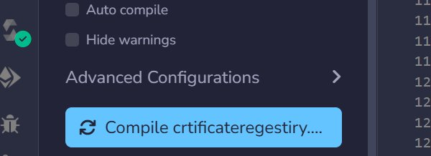
🎬 Live Demo — Remix IDE Simulation (Step 1/10)
Step 1 Compile Contract — crtificateregestiry.sol ✅

Slide 11

🎬 Live Demo — Remix IDE Simulation (Step 2/10)
Step 2 Deploy Contract — Deploy button ✅

Slide 12
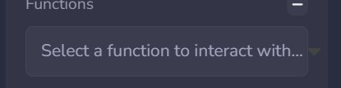
🎬 Live Demo — Remix IDE Simulation (Step 3/10)
Step 3 Select Function to Interact With

Slide 13
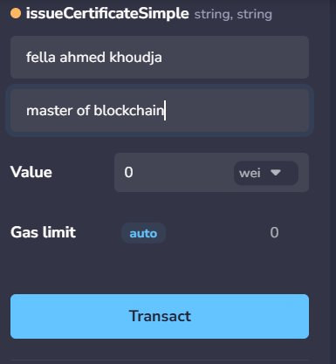
🎬 Live Demo — Remix IDE Simulation (Step 4/10)
Step 4 issueCertificateSimple — fella ahmed khoudja / master of blockchain ✅

Slide 14
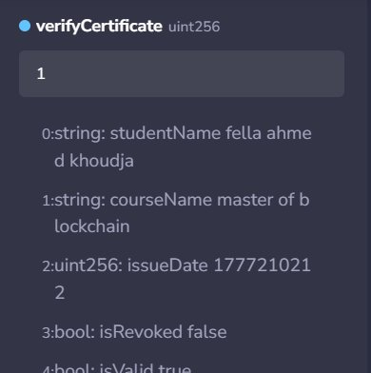
🎬 Live Demo — Remix IDE Simulation (Step 5/10)
Step 5 verifyCertificate ID:1 — isRevoked:false, isValid:true ✅ VALID

Slide 15
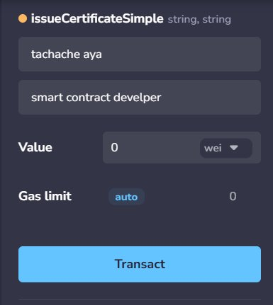
🎬 Live Demo — Remix IDE Simulation (Step 6/10)
Step 6 issueCertificateSimple — tachche aya / smart contract developer ✅

Slide 16
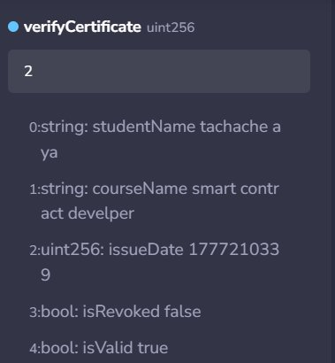
🎬 Live Demo — Remix IDE Simulation (Step 7/10)
Step 7 verifyCertificate ID:2 — isRevoked:false, isValid:true ✅ VALID

Slide 17
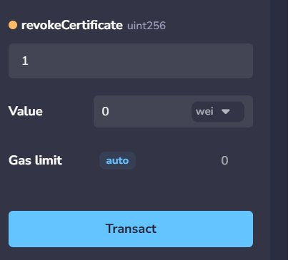
🎬 Live Demo — Remix IDE Simulation (Step 8/10)
Step 8 revokeCertificate ID:1 → Transact — Certificate Revoked ✅

Slide 18
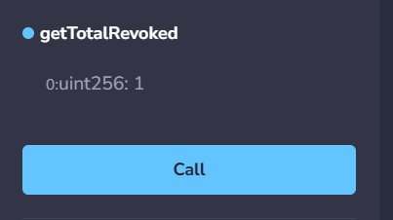
🎬 Live Demo — Remix IDE Simulation (Step 9/10)
Step 9 getTotalRevoked() → 1 | Fraud prevention confirmed ✅

Slide 19
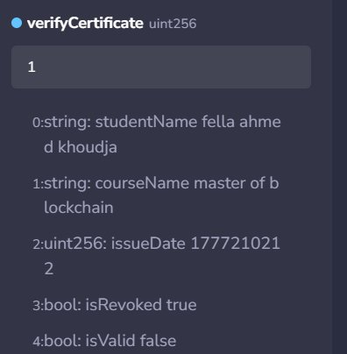
🎬 Live Demo — Remix IDE Simulation (Step 10/10)
Step 10 verifyCertificate ID:1 (After Revoke) — isRevoked:true, isValid:false ❌

Slide 20
🔒 Advantages of Blockchain Verification
🔐
Secure
👁️
Transparent
🛡️
Tamper-Proof
SHA-256 cryptographic hashing makes certificates mathematically impossible to forge or alter.
All certificate records are publicly visible on the blockchain — full auditability for anyone.
Once recorded, data cannot be deleted or modified. Consensus mechanism prevents any alteration.
⚡
Fast Verification
💰
Cost Savings
🌍
Global Access
Verification takes under 1 second — compared to 3–6 weeks for traditional manual processes.
Eliminates verification staff costs. ROI achieved within 3 months of deployment.
Verify certificates from anywhere in the world, 24/7, with no office hours or borders.

Slide 21
⚠️ Limitations & Challenges
Every technology has trade-offs. Here are the honest limitations of our current implementation:
📡
Requires Internet Connection
Impact: Medium
Both issuing and verifying certificates requires an active internet connection to interact with the blockchain network. Offline use is not possible.
⛽
Gas Fees (Ethereum Mainnet)
Impact: High
Writing to Ethereum mainnet incurs gas fees in ETH. Our demo uses Remix VM (free), but real deployment requires ETH. Testnet deployment is free for development.
🧩
Technical Complexity
Impact: Medium
Not beginner-friendly. Requires understanding of Solidity, blockchain concepts, and wallet management. Training would be needed for institution staff.
📊
Scalability Limitations
Impact: Low
Ethereum processes ~15-30 TPS. For very large institutions issuing thousands of certificates daily, Layer 2 solutions or alternative chains may be needed.
💡 These limitations can be addressed in future versions — see Slide 12 for our roadmap

Slide 22
🚀 Future Improvements & Roadmap
📱
Phase 1
📲
Phase 1
🏫
Phase 2
QR Code Verification
Mobile Application
University Database Integration
Embed QR codes on physical diplomas that link directly to the blockchain verification endpoint. One scan = instant verification.
Cross-platform mobile app for students to store credentials and share with employers. Real-time verification on any device.
Direct API integration with university student information systems for automatic certificate issuance upon graduation.
📁
Phase 2
🤖
Phase 3
🌐
Phase 3
IPFS Decentralized Storage
AI Fraud Detection
Cross-Institution Network
Store full certificate PDFs on IPFS and record the IPFS hash on-chain. Permanent, decentralized document storage.
Machine learning layer to detect suspicious verification patterns and flag potential fraud attempts in real-time.
Multi-institution consortium blockchain where universities worldwide share a single verification network.

Slide 23
📌 Conclusion
Blockchain makes credential fraud mathematically impossible — not just difficult.
🔒
🚫
⚡
Blockchain Builds Trust
Eliminates Fake Certificates
Efficient Verification
By replacing human trust with cryptographic proof, blockchain creates a system where certificate authenticity is verifiable by anyone, anywhere, at any time.
The immutability of blockchain records and SHA-256 hashing makes it mathematically impossible to create or alter certificates without detection.
What used to take 3–6 weeks of phone calls and paperwork now takes 0.4 seconds with complete certainty — transforming the verification industry.
0.4s
∞
0%
24/7
Verification
Records
Forgery Rate
Availability

Slide 24
Thank You
for your attention
Blockchain Certificate Verification System
Ahmed Khoudja Fella • Tachche Aya
❓ Questions & Discussion
⛓ Blockchain
💻 Solidity
🔷 Ethereum
🔐 Smart Contracts

